Slide 1

Chapter 12
Religion
Notes:
For a better classroom presentation flow, the order of some topics in this lecture outline differs slightly from the order of topics in the text and, where this occurs, some figures and tables are out of numerical order.

Slide 2
Learning Objectives
12.1 Describe how anthropologists define religion and its key features.
12.2 Recognize how globalization has affected world religions.
12.3 Identify examples of religious change in contemporary times.

Slide 3
Religion in Comparative Perspective
12.1 Describe how anthropologists define religion and its key features.
What Is Religion?
Varieties of Religious Beliefs
Ritual Practices
Religious Specialists

Slide 4
What Is Religion? (1 of 2)
As in all of anthropology, the challenge is to find a definition that is broad enough to fit all cultures
Current definition says that religion is beliefs and behavior related to supernatural beings and forces
  As far as we know, only humans have it

Slide 5
What Is Religion? (2 of 2)
Magic Versus Religion
  Nineteenth-century thinkers supported a cultural evolution model that said magic came first, replaced by religion, and religion was replaced by science
  Magic defined as: people’s attempts to compel supernatural forces and beings to act in certain ways, often to harm enemies

Slide 6
Varieties of Religious Beliefs (1 of 6)
Cross-culturally, people express their religious beliefs in many ways
Cultural anthropologists classify these expressions into:
  Myths
  Doctrine

Slide 7
Varieties of Religious Beliefs (2 of 6)
Myths
  Convey information about supernaturals through the story itself
  Indirect messages
  Usually part of the oral (verbal) tradition

Slide 8
Varieties of Religious Beliefs (3 of 6)
Three functional anthropological theories about myths:
  Malinowski: myths are a “charter” for society; they provide a rationale for the group
  Lévi-Strauss: myths express the underlying beliefs of a society and help people resolve deep contradictions between life and death and other binary oppositions
  Cultural materialists: example in the text showing that myths store knowledge for cultural survival
    Example: theme of food availability in Klamath and Modoc myth

Slide 9
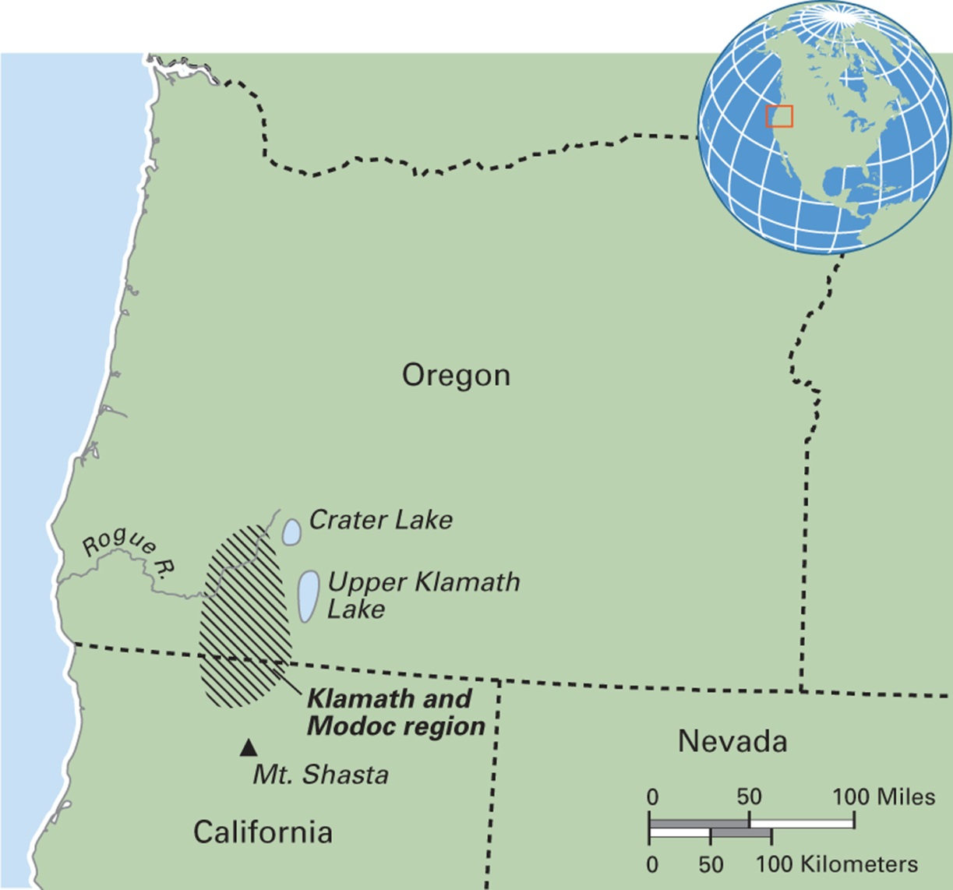
Map 12.1 Klamath and Modoc Region in Oregon and California

Slide 10
Varieties of Religious Beliefs (4 of 6)
Doctrine
  Direct statements about religious beliefs
  Written and formal
  Associated with state-level religions
  Doctrine can and does change
    Example: Islamic doctrine as expressed in the Qur’an, debated among contemporary Muslims regarding issues such as polygyny, divorce, women’s work roles, women’s clothing

Slide 11
Varieties of Religious Beliefs (5 of 6)
Beliefs about supernaturals
  Animatism
  Zoomorphic supernaturals
  Anthropomorphic supernaturals
  Pantheons
  Ancestors

Slide 12
Varieties of Religious Beliefs (6 of 6)
Sacred spaces
  Natural sites such as mountains, streams, stone outcroppings
  Temporary sacred spaces created through ritual
    Example: khatam quran in Manchester, England

Slide 13
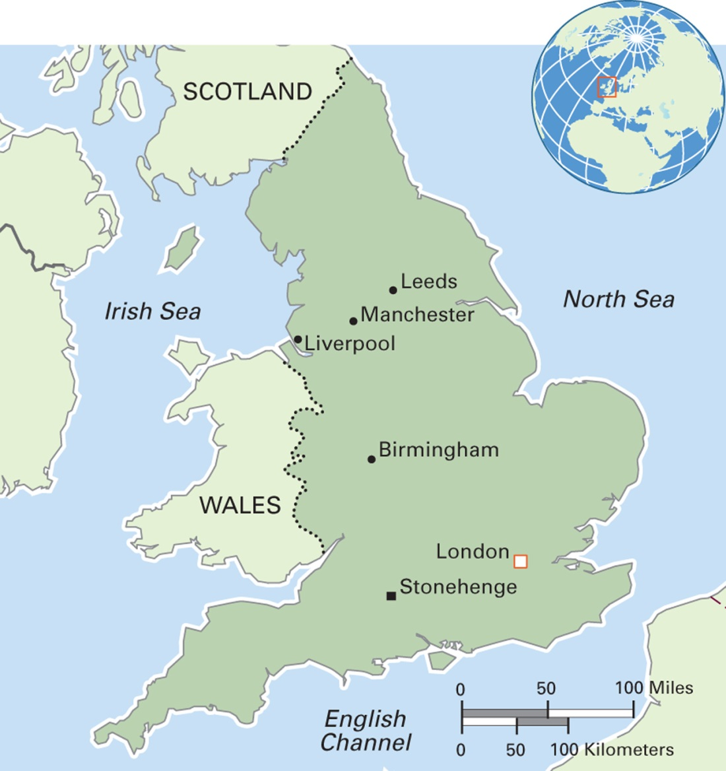
Map 12.3 England
Notes:
England is the largest in area and the most populous of the constituent countries of the United Kingdom. Its population of 53 million accounts for 84 percent of the total. DNA analysis reveals that a majority of the English are of Germanic descent, as is their language. The terrain is mainly rolling hills, with some mountains in the north and east. London is by far the largest city, with Manchester and Birmingham competing for second place. English is the dominant language with its diverse regional accents. Many other languages brought into the country by immigrant communities are spoken as first languages, including several South Asian languages, Polish, Greek, and Cantonese. An estimated 250,000 people speak British Sign Language. Although the Church of England is the state religion, everyone in England has the right to religious freedom.

Slide 14
Eye on the Environment: Eagle Protection, National Parks, and the Preservation of Hopi Culture (1 of 3)
Golden eagles among the Hopi Indians of Arizona:
  Golden eagles are the Hopi people’s link to the spiritual world
  Their ritual use (and sacrifice) is essential to the continuity of Hopi culture

Slide 15
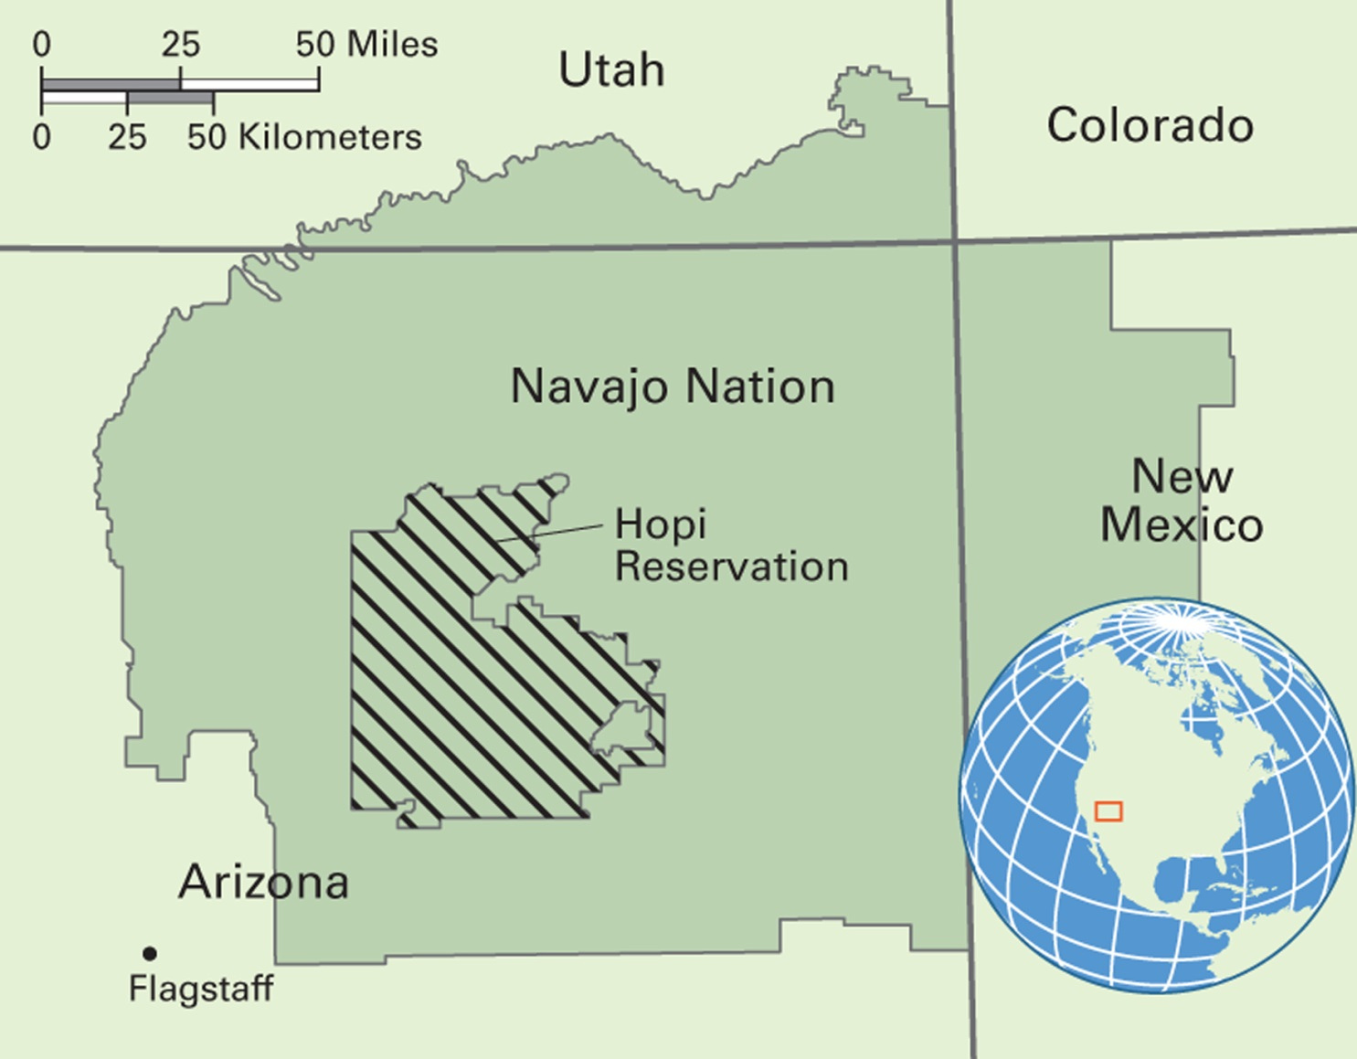
Map 12.2 Hopi Reservation in Arizona
Notes:
The Hopi and Navajo tribes once shared the area known as Big Mountain. U.S. Acts of Congress in 1974 and 1996 divided the area into two reservations, leaving the Hopi completely surrounded by the much larger Navajo Nation. About 7,000 people live on the Hopi Reservation.

Slide 16
Eye on the Environment: Eagle Protection, National Parks, and the Preservation of Hopi Culture (2 of 3)
In 1962, Congress protected golden eagles along with bald eagles
The Yellowstone model: parks without people
President Clinton established a repository for golden eagle feathers and remains
The Hopi have a permit for an annual take of 40 golden eagles but their hunting grounds are limited because of a national park

Slide 17
Eye on the Environment: Eagle Protection, National Parks, and the Preservation of Hopi Culture (3 of 3)
Anthropologists support environmental and species preservation, but not to the exclusion of heritage populations and cultures: parks and people
Golden eagles are abundant and the Hopi requests for the spring take present no threat to the survival of the species

Slide 18
Anthropology Works: Aboriginal Women’s Culture and Sacred Site Protection
Ngarrindjeri women hired cultural anthropologist Diane Bell to help them support their claims to a sacred site on Hindmarsh Island
They were trying to prevent construction of a bridge that would cross sacred waters
Bell gathered evidence to prove their case
  Newspaper archives, early recordings of ritual songs, and oral histories
In 1999, the judge canceled the bridge project
Land developers kept pressing, and in 2001, the bridge was built

Slide 19
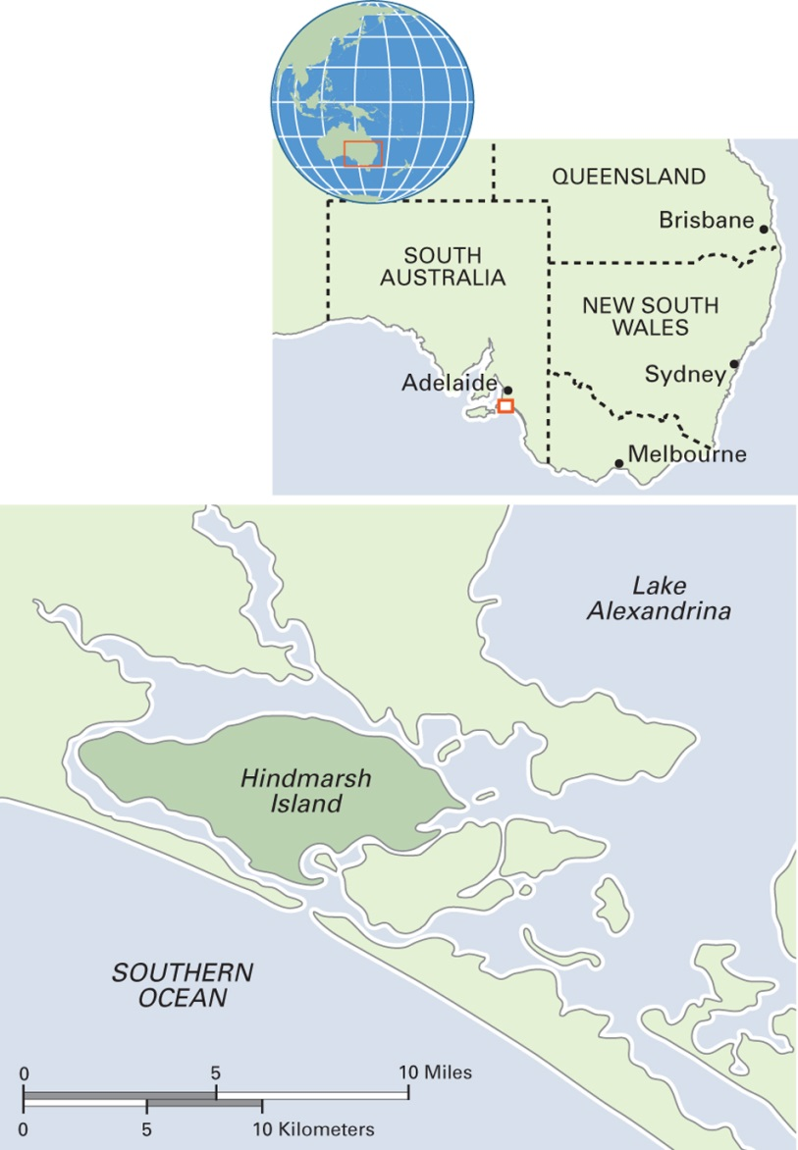
Map 12.4 Hindmarsh Island in Southeast Australia
Notes:
The Ngarrindjeri name for Hindmarsh Island is Kumarangk.

Slide 20
Ritual Practices (1 of 5)
Ritual: patterned behavior that has to do with the supernatural realm
  Life-cycle rituals
  Pilgrimage
  Rituals of inversion
  Sacrifice

Slide 21
Ritual Practices (2 of 5)
Life-Cycle Rituals
  Mark change in status or life stage
  Cross-culturally, life-cycle rituals often have the following phases:
    Separation: physical, social, or symbolic
    Liminal: the person is neither in one category nor the other
    Reintegration: initiates “emerge” back into society and their new status

Slide 22
Ritual Practices (3 of 5)
Pilgrimage
  Round-trip travel to a sacred location for the purpose of devotion
  Often includes a theme of hardship

Slide 23
Ritual Practices (4 of 5)
Rituals of Inversion
  Normal social roles and relations are temporarily reversed or relaxed
  Example: carnival in southern Europe and the Western Hemisphere
    Riotous celebration, cross-dressing, relaxed social expectations
  Do these rituals act to maintain social order?

Slide 24
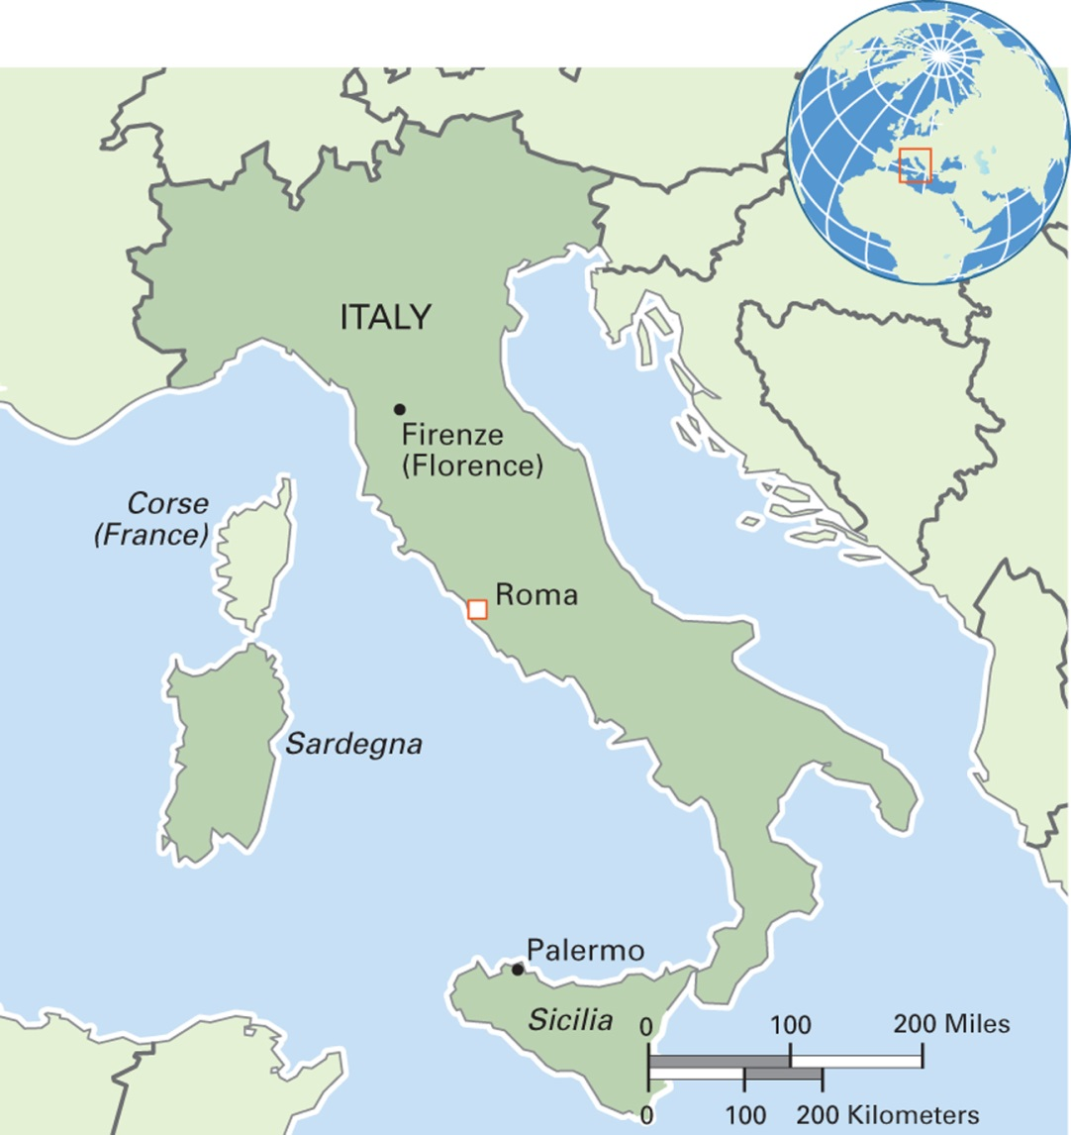
Map 12.5 Italy
Notes:
Officially the Italian Republic, the country includes the mainland and two large islands. In 2015, Italy had the eighth largest economy in the world. A mountain system forms the backbone of the peninsula, and the climate varies according to altitude. Its population of nearly 61 million people makes it one of the most densely populated countries in Europe. Roman Catholicism is the dominant religion. Recent waves of immigration, especially from northern Africa, have increased the number of Muslims to over 1 million. The official language is standard Italian, descended from the Tuscan dialect of Firenze (Florence). Many cherished dialects of Italian exist throughout the country, and people in northern border provinces speak dialects of German and French. Italy has the largest number of UNESCO World Heritage Sites of any country.

Slide 25
Ritual Practices (5 of 5)
Sacrifice
  A gift or transfer of something to the supernaturals
  May take form of animals, humans, food, or other products
  Example: Aztec human sacrifice
    Scale of the sacrifices debated
    Source of protein for lower classes?

Slide 26
Religious Specialists (1 of 3)
  Shaman/shamanka
  Priest/priestess
  Diviner
  Prophet
  Others

Slide 27
Religious Specialists (2 of 3)
Shaman/shamanka
  Religious specialist with direct association with the supernaturals
  Most associated with nonstate societies
  “Called” to the profession

Slide 28
Religious Specialists (3 of 3)
Priest/priestess
  Associated with states
  Full-time religious specialists
  Formal training
  Priestly lineage
  Perform wider range of rituals than shamans/shamankas
  May have substantial secular (worldly) power

Slide 29
World Religions and Local Variations (1 of 3)
12.2 Recognize how globalization has affected world religions.
World religions: text-based; have many followers; cross country borders
  Hinduism
  Buddhism
  Judaism
  Christianity
  Islam
  African religions: not text-based

Slide 30
World Religions and Local Variations (2 of 3)
Anthropology and world religions
  What is the impact of a world religion in a new, local context?
  How do local cultures reshape world religions?
  Key concepts:
    Religious pluralism
    Religious syncretism

Slide 31
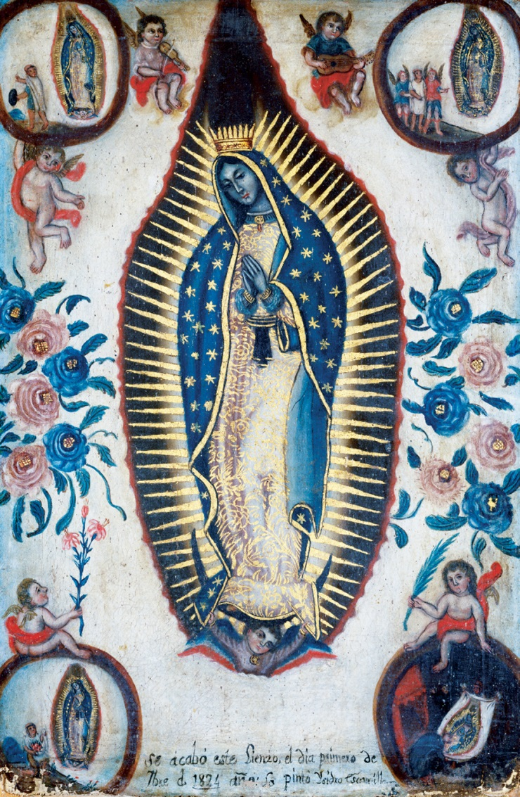
World Religions and Local Variations (3 of 3)
Notes:
A nineteenth-century painting of the Virgin of Guadalupe by Isidro Escamilla, a Mexican artist. The Virgin of Guadalupe, or Our Lady of Guadalupe, is Mexico’s most popular image. Her depiction involves syncretism with the indigenous Aztec goddess Tonantzin, part of a conscious strategy of Christian clergy to convert the Indians. Today, the Virgin of Guadalupe conveys messages of sacrifice and nurturance as well as strength and hope. She appeals to Mexican mothers, nationalists, and feminists alike.

Slide 32
Hinduism
Most Hindus live in India
Core text: the four Vedas
Rich polytheism
Incorporates a diversity of ways to be Hindu
“Unity in diversity”
Sacred sites range from monumental trees to piles of stones

Slide 33
Buddhism
Founding figure: Siddhartha Gautama
Started in northern India
No accepted single text
First arose as protest against social inequality of Hinduism
Goal is to achieve nirvana
Strong tradition of monasticism
Began in India but spread into East Asia

Slide 34
Think Like an Anthropologist:
Tattoos and Sacred Power (1 of 2)
Example of religious syncretism
For the Shan people of northern Thailand, tattooing blends aspects of Buddhism with local spirit beliefs and elements of Hinduism
Tattoos may:
  Act on other people, causing the bearer to be liked or feared
  Increase bearer’s skill
  Create protective barriers

Slide 35
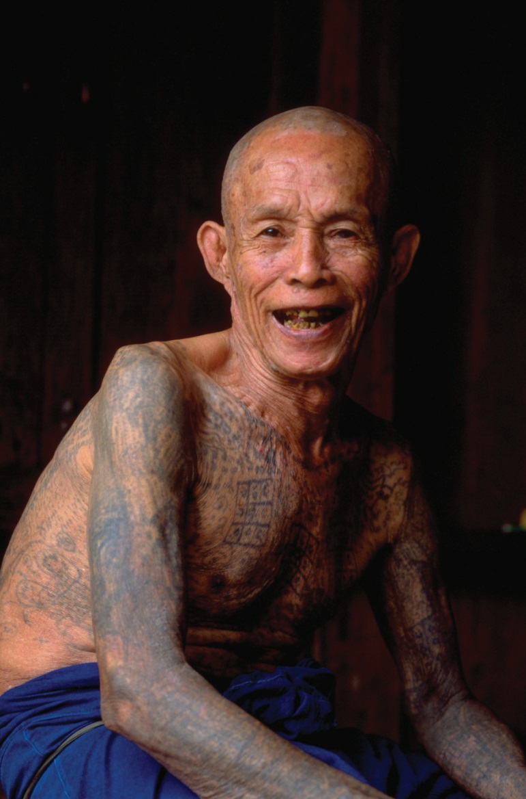
Think Like an Anthropologist:
Tattoos and Sacred Power (2 of 2)
Notes:
Over 100 years old, this Shan man of northern Thailand is testimony to positive life forces, whether inscribed on his body as protective tattoos . . . or because of his more healthy, non-industrial lifestyle?

Slide 36
Judaism
Origins about 500 BCE
Theme of exile and return
Key text: Pentateuch, or Torah
Monotheistic
Words, both spoken and written, are important
Contemporary varieties from conservative to reform

Slide 37
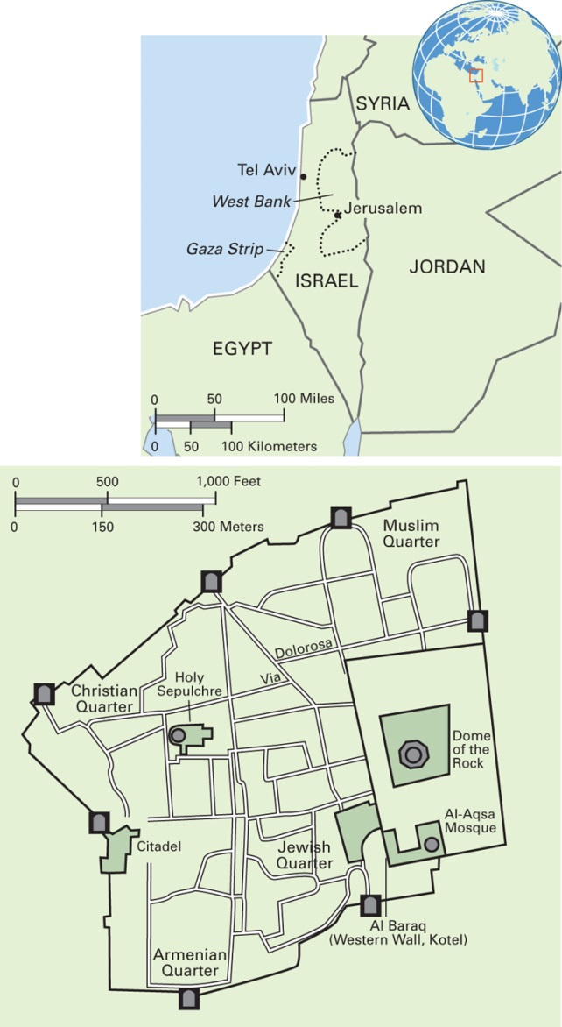
Map 12.6 Sacred Sites in the Old City of Jerusalem, Israel
Notes:
Jerusalem is the holiest city of Judaism, the third holiest city of Islam, and holy to Christians. The section called the Old City is surrounded by walls that have been built, razed, relocated, and rebuilt over several hundred years. The Old City contains four quarters—Armenian, Christian, Jewish, and Muslim—and many sacred sites, such as the Kotel and the Via Dolorosa.

Slide 38
Christianity
Largest of the world religions
Basic text is the Bible
Teachings of Jesus as model for behavior
Many branches and denominations worldwide

Slide 39
Islam
Youngest of the world religions
Second-largest world religion
Based on the teachings of Muhammad
Sunni and Shi’a are the two major branches
Local variations in ritual practices

Slide 40
Culturama: Hui Muslims of Xi’an, China
The Hui are one of China’s largest designated minorities (around 10 million)
The state classifies them as “backward” and “feudal”
The Hui of Xi’an construct a modern and civilized lifestyle by choosing aspects of Muslim and Western cultures
Their diet (no pork or alcohol) sets them apart from the Han culture

Slide 41
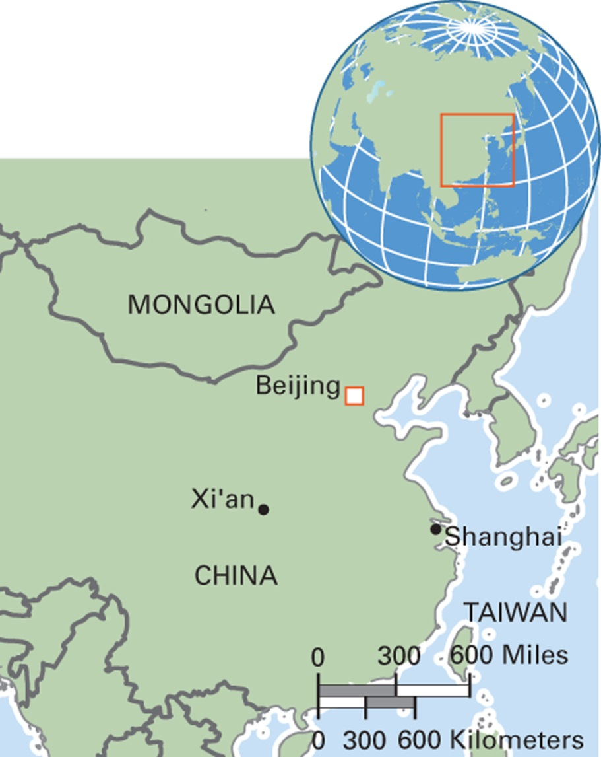
Map 12.8 The City of Xi’an in China
Notes:
Xi’an, the capital of Shaanxi province, is one of the most economically developed cities in the northwestern part of China.

Slide 42
African Religions
Myths about a split between creator deity and humans
A pantheon of supernaturals
Elaborate initiation rituals and sacrifices
Altars within shrines
Close links with healing
New forms emerging, especially in the Western Hemisphere (umbanda, Rastafarianism, etc.)

Slide 43
Directions of Religious Change
12.3 Identify examples of religious change in contemporary times.
Revitalization Movements
Contested Sacred Sites
Religious Freedom as a Human Right

Slide 44
Revitalization Movements
Seek to bring about positive change by reconstructing parts of religion threatened by outside forces
Example: Ghost Dance movement
  Response to invasion of land by White people
  Predicted destruction followed by renewal
Example: cargo cults
  Found in Melanesia
  Based around prophetic figures who claim knowledge of when manufactured goods (“cargo”) would appear

Slide 45
Contested Sacred Sites
Example: Jerusalem
  Judaism, Christianity, and Islam claim primary rights over sacred sites
Example: India
  Sites sacred to Hindus and/or Muslims are often flashpoints for conflict
Urban expansion often creates disputes as development encroaches on burial grounds, archaeological remains, or other sacred terrain

Slide 46
Religious Freedom as a Human Right
Freedom from religious persecution a human right according to the United Nations
Example: Tibetan Buddhists
  Thousands of refugees fled Tibet after takeover by the Chinese

